Slide 1
MODULE 2: 5G Network Architecture
M2 S2
5G Core Network (5GC)

Slide 2
5G Core Network (5GC)
Core networks traditionally have been designed as a single architecture addressing a range of requirements and supporting backward compatibility.
This one size fits all approach has been successful in keeping the costs down to a reasonable level and by supporting legacy circuit switched and today’s packet switched functionalities.
This core network, however, is rigid in the sense that it is not flexible enough to accommodate the customized and variable connectivity needs of individual users and businesses that are expected in the future.
However, with virtualization, NFV, SDN, and network slicing, it is possible to make core networks more flexible and scalable.
Thus, the next generation core network is expected to exist in a cloud-based environment with a high degree of virtualization and software-based networking.
Such flexibility is needed to support a variety of access networks such as 3G, LTE, 4G, WiFi, and tomorrow’s 5G.

Slide 3
5G Core Network (5GC)
Components of Core Network/High Level Architecture.
The current EPC will further evolve to support virtualization and network slicing to become NGC applicable for 5G networks.
Network slicing is often termed as logical instantiation of a network possibly due to virtualization technologies.
The concept is seen as the natural extension/evolution of the current network sharing methodologies.
Network slicing is one of the promising techniques that will likely exist in both radio access and core networks. It allows multiple logical networks to be created on top of a common physical infrastructure.

Slide 4
5G Core Network (5GC)
Components of Core Network/High Level Architecture.
Either DCN (Dedicated Core Network) or a combination of NFV and SDN can be used as a technology to enable network slicing along with orchestration and analytics.
DCN or Décor as defined in 3GPP TS 23.401 is a feature that enables an operator to deploy multiple logical mobile core networks connected to the same RAT or multiple RATs (e.g. GERAN, UTRAN, E-UTRAN, WB-E-UTRAN and NB-IoT).
A DCN consists of one or more MME/SGSN and it may be comprised of one or more SGW/PGW/PCRF.
This feature enables subscribers to be allocated to and served by a DCN based on subscription information (e.g., “UE Usage Type”).

Slide 5
5G Core Network (5GC)
Components of Core Network/High Level Architecture.
With 5G, a single terminal can use multiple services with different characteristics almost simultaneously.
In such cases, a network slice can be created for each service, requiring all such slices to coordinate control for that particular single terminal.
These slices can be mapped to respective radio and core network slices to provide end-to-end connectivity.
The methodology is currently being specified for selecting radio/core networks particularities for supporting slicing in existing as well as in future 5G systems.

Slide 6
!!THANK YOU!! !! Have a Nice Day!!
Today we learned about
5G Core Network (5GC)

Slide 7
MODULE 2: 5G Network Architecture
M2 S3
5G System Architecture

Slide 8
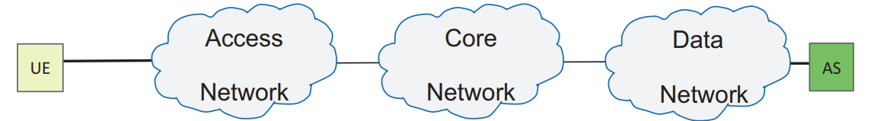
5G System Architecture
Fig. 1. End-to-end architecture
The 3GPP 5G system defines the architecture for communication between a User Equipment (UE) and an end point, such as an Application Server (AS) in the Data Network (DN), or another UE.
The interaction between the UE and the Data Network is via the Access Network and Core Network as defined by 3GPP Standards.
Figure 1 depicts a simple representation of an end-to-end architecture.
In this Unit we will focus on describing the 5G Core as defned by 3GPP 5G standards for Public land mobile network (PLMN).
The Access Network in 3GPP is referred to as Radio Access Network (RAN).

Slide 9
5G System Architecture
At a very high level, the Core and RAN consist of several Network Functions which are associated with Control Plane and User Plane functionalities.
The actual data (also refer it as user data) is normally transported via a path in the User Plane, while the Control Plane is used to establish the path in the User Plane.
The Short Message Service (SMS) is an exception in which the data (short message) is communicated via the Control Plane

Slide 10
5G System Architecture
The 5G System architecture (5GS) is represented in two ways in the 3GPP standards, one is a service-based representation in which the control plane network functions access each other’s services, and the other is a reference point representation in which the interaction between the network functions is shown with point-to point reference points.
In this unit we use the service-based representation since the 5G architecture is defind as service-based architecture

Slide 11
5G System Architecture
In current specifications, the Service-based interfaces are defned within the Control Plane only.
In 3GPP terminology, “a network function can be implemented either as a network element on a dedicated hardware, as a software instance running on a dedicated hardware, or as a virtualized function instantiated on an appropriate platform, e.g. on a cloud infrastructure.”
The Release 16 specifications add capability for Direct Communication and Indirect Communication between the Network Functions and Network Function services.
The indirect communication is via a Service Communication Proxy (SCP).
The SCP is not used for Direct Communication.

Slide 12
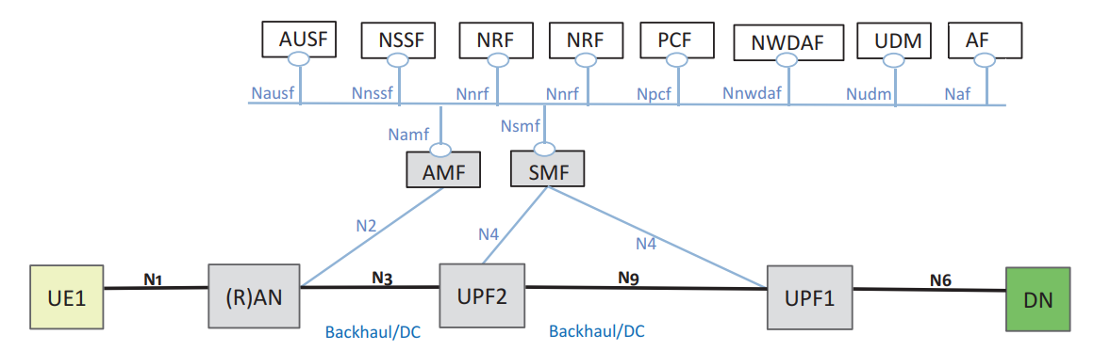
5G System Architecture
Fig. 2. 5G System architecture
The 3GPP 5GS service based non-roaming reference architecture in shown in Fig.

Slide 13
5G System Architecture
in Release-14 (4G) was enhanced with an optional feature that allowed separation of control plane and user plane.
In this feature, the Serving Gateway (SGW) and Packet Gateway (PGW) are divided into distinct control plane and user plane functions (e.g., SGW-C and SGW-U).
This optional feature provided more flexibility and efficiency in network deployment.
In 5G architecture, the separation of control plane and user plane is an inherent capability.
The Session Management Function (SMF) handles the control plane functionality for setup and management of sessions, while the actual user data is routed through the User Plane Function (UPF).

Slide 14
5G System Architecture
Fig. 2. 5G System architecture
The 3GPP 5GS service based non-roaming reference architecture in shown in Fig.

Slide 15
5G System Architecture
In 5G architecture, the separation of control plane and user plane is an inherent capability.
The Session Management Function (SMF) handles the control plane functionality for setup and management of sessions, while the actual user data is routed through the User Plane Function (UPF).
The UPF selection (or re-selection) is handled by SMF.
The deployment options allow for centrally located UPF and/or distributed UPF located close to or at the Access Network

Slide 16
5G System Architecture
Fig. 2. 5G System architecture
The 3GPP 5GS service based non-roaming reference architecture in shown in Fig.

Slide 17
5G System Architecture
The Access and Mobility Management function (AMF) handles the mobility management and procedures.
AMF is termination point for control plane connection from (Radio) Access Network ((R)AN) and UE.
The connection between UE and AMF (which traversed through RAN) is referred to as Non-Access Stratum (NAS).
The Session Management Function (SMF) handles the session management procedures.
The separation of the mobility and session management functionalities allows for one AMF to support different Access Networks (3GPP and non-3GPP), while SMF can be tailored for specific Accesses

Slide 18
5G System Architecture
Fig. 2. 5G System architecture
The 3GPP 5GS service based non-roaming reference architecture in shown in Fig.

Slide 19
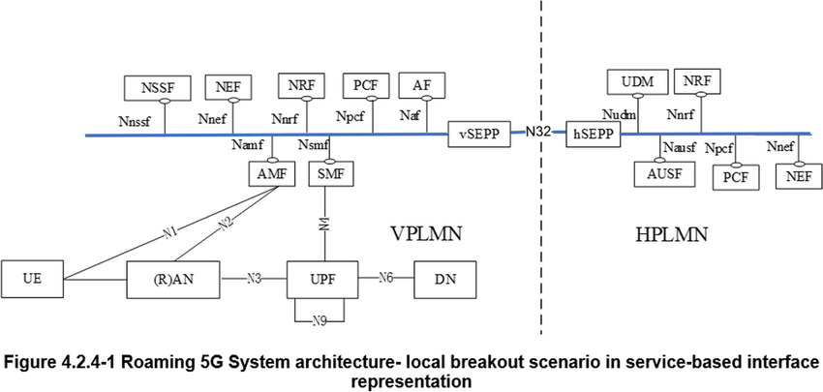
5G System Architecture
Fig. Roaming 5G System architecture—local breakout scenario

Slide 20
Fig. Roaming 5G System architecture—local breakout scenario
Figure shows a Roaming architecture with local breakout at the Visited Public land mobile network (VPLMN).
In this scenario the Unifed Data Management (UDM), which includes the subscription information, Authentication Server Function (AUSF), which includes authentication/authorization data, and Network Slice-Specifc Authentication and Authorization Function (NSSAAF), which support Network Slice-Specifc Authentication and Authorization, are located in the Home PLMN (HPLMN)

Slide 21
There are Security Edge Protection Proxies (SEPP) that protect the communication between the Home and Visited PLMNS.
UE communicates to Data Network (DN) via the User Plane Functions (UPF) in the VPLMN.
The AMF and the Session Management Function (SMF) which handle the mobility and the session management for the UE are located in the VPLMN as well

Slide 22
!!THANK YOU!! !! Have a Nice Day!!
Today we learned about
5G System Architecture

